Slide 1
Group 4:
Raghav Chopra (C0772292)
Project: IOT based smart garage door opener
Topic: Interfacing of Arduino with Keypad

Slide 2
Contents
Task objective
Components required for interfacing
Introduction of Arduino UNO
Pin layout of Arduino UNO
Technical Specifications of Arduino UNO
Introduction of Keypad
4x4 keypad pin configuration
Features and specifications of 4x4 keypad
Applications of 4x4 keypad

Slide 3
Cont.
Hardware Connections
Code
Terminal output
references

Slide 4
Task objective
The main function of this task is to interface the Arduino with the keypad.
To connect the proper hardware connections so that both components can communicate easily.
To execute the code so that we can get the exact output on the terminal.

Slide 5
Components Required for Interfacing
Hardware components
Arduino UNO
Keypad
Jumper wires
USB cable
LCD display
Software components
Linux operating system
Arduino IDE
LCD libraries
Keypad libraries

Slide 6
Introduction of Arduino UNO
The Arduino UNO is an open source microcontroller board which is based on the microchip ATmega328P (for Arduino UNO R3) or microchip ATmega4809 (for Arduino UNO wifi R2) microcontroller by Atmel and was the first USB powered board developed by Arduino.It contains everything needed to support the microcontroller, simply connect it to a computer with a USB cable or power it with a AC-to-DC adapter or battery to get started.

Slide 7
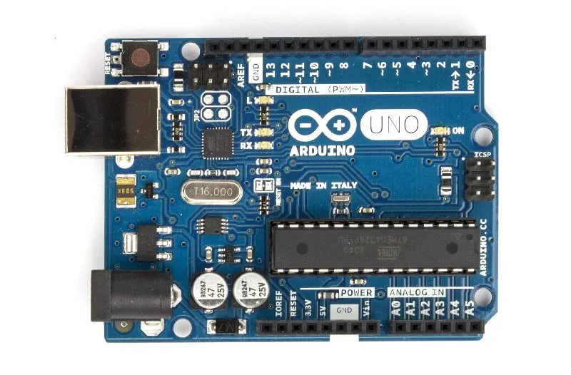
Arduino UNO

Slide 8
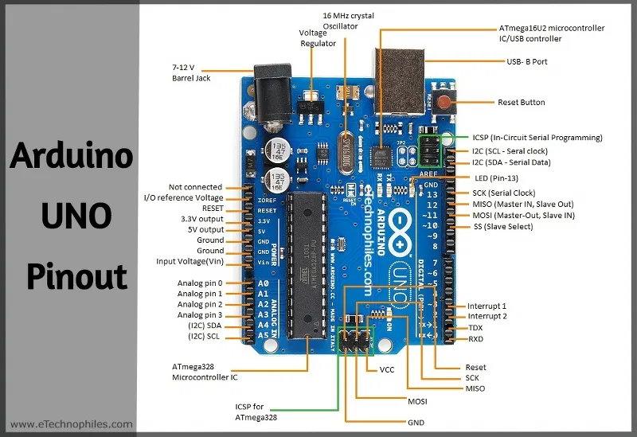
Pin layout of Arduino UNO

Slide 9
Pin Description
6 Analog inputs
14 digital input/output pins (6 pins can be used as PWM outputs)
16 MHz ceramic crystal resonator
USB port
An ICSP header
A power jack
A reset button

Slide 10
Technical Specifications of Arduino UNO
Microcontroller - ATmega328p
Operating voltage - 5 V
Input voltage - 6 to 20 V
Digital I/O pins - 14 (6 of which used for PWM)
Analog Input pins - 6
Flash memory - 32 KB
SRAM - 2KB (ATmega328)
EEPROM - 1KB (ATmega328)
Clock speed- 16 MHz
Length - 6 mm
Width - 4 mm
Weight - 25 g

Slide 11
Introduction of Keypad
A keypad is a set of buttons arranged in a block or pads which bear digits, symbols or alphabetical letters.
Keypads are found on devices which require mainly numeric inputs such as calculators, point of sale devices, combination locks and digital door locks.

Slide 12
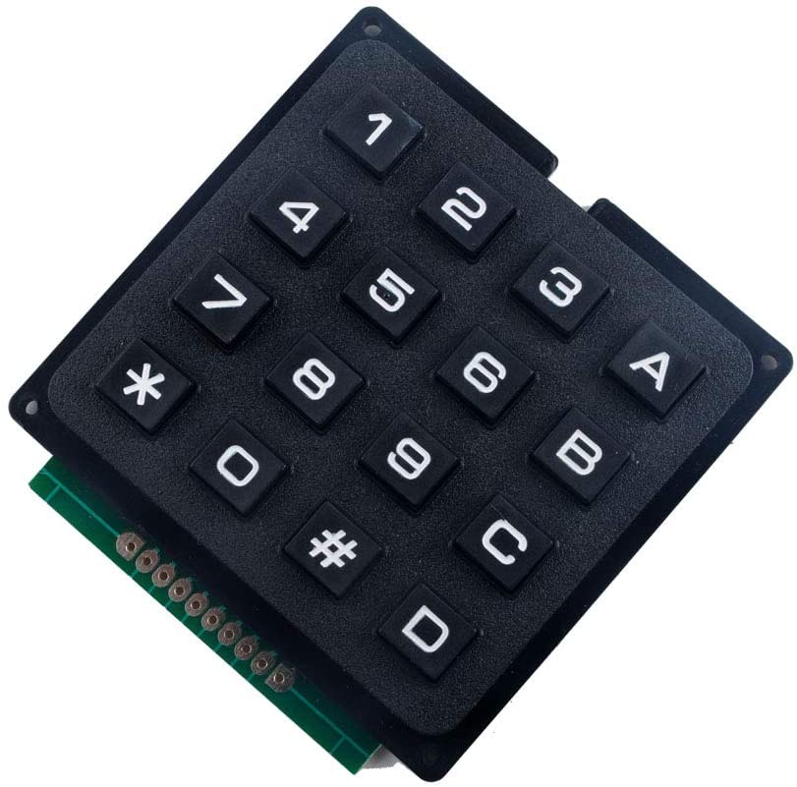
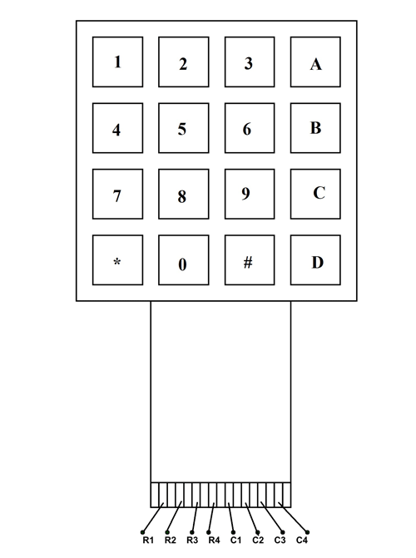
4x4 Keypad Module

Slide 13
4x4 keypad pin configuration
Pin number Description
ROWS
1 PIN1 is taken out from 1st ROW
2 PIN2 is taken out from 2nd ROW
3 PIN3 is taken out from 3rd ROW
4 PIN4 is taken out from 4th ROW
COLUMN
5 PIN5 is taken out from 1st COLUMN
6 PIN6 is taken out from 2nd COLUMN
7 PIN7 is taken out from 3rd COLUMN
8 PIN8 is taken out from 4th COLUMN

Slide 14
Cont.
It has Eight terminals:
four of them are Rows of matrix
four are Column of matrix.
Eight pins are driven out from the 16 buttons present on the module.

Slide 15
Features and Specifications of 4x4 keypad
Maximum voltage across each button: 24 V
Maximum current through each button: 30 mA
Maximum operating temperature: 0 to +50 degree celsius
Ultra-thin design
Easy to interface
Long life
Adhesive backing

Slide 16
Applications of 4x4 keypad
Security systems
Industrial machines
Vending machines
Engineering systems
Data entry for Embedded systems
Basically, anywhere input device is needed

Slide 17
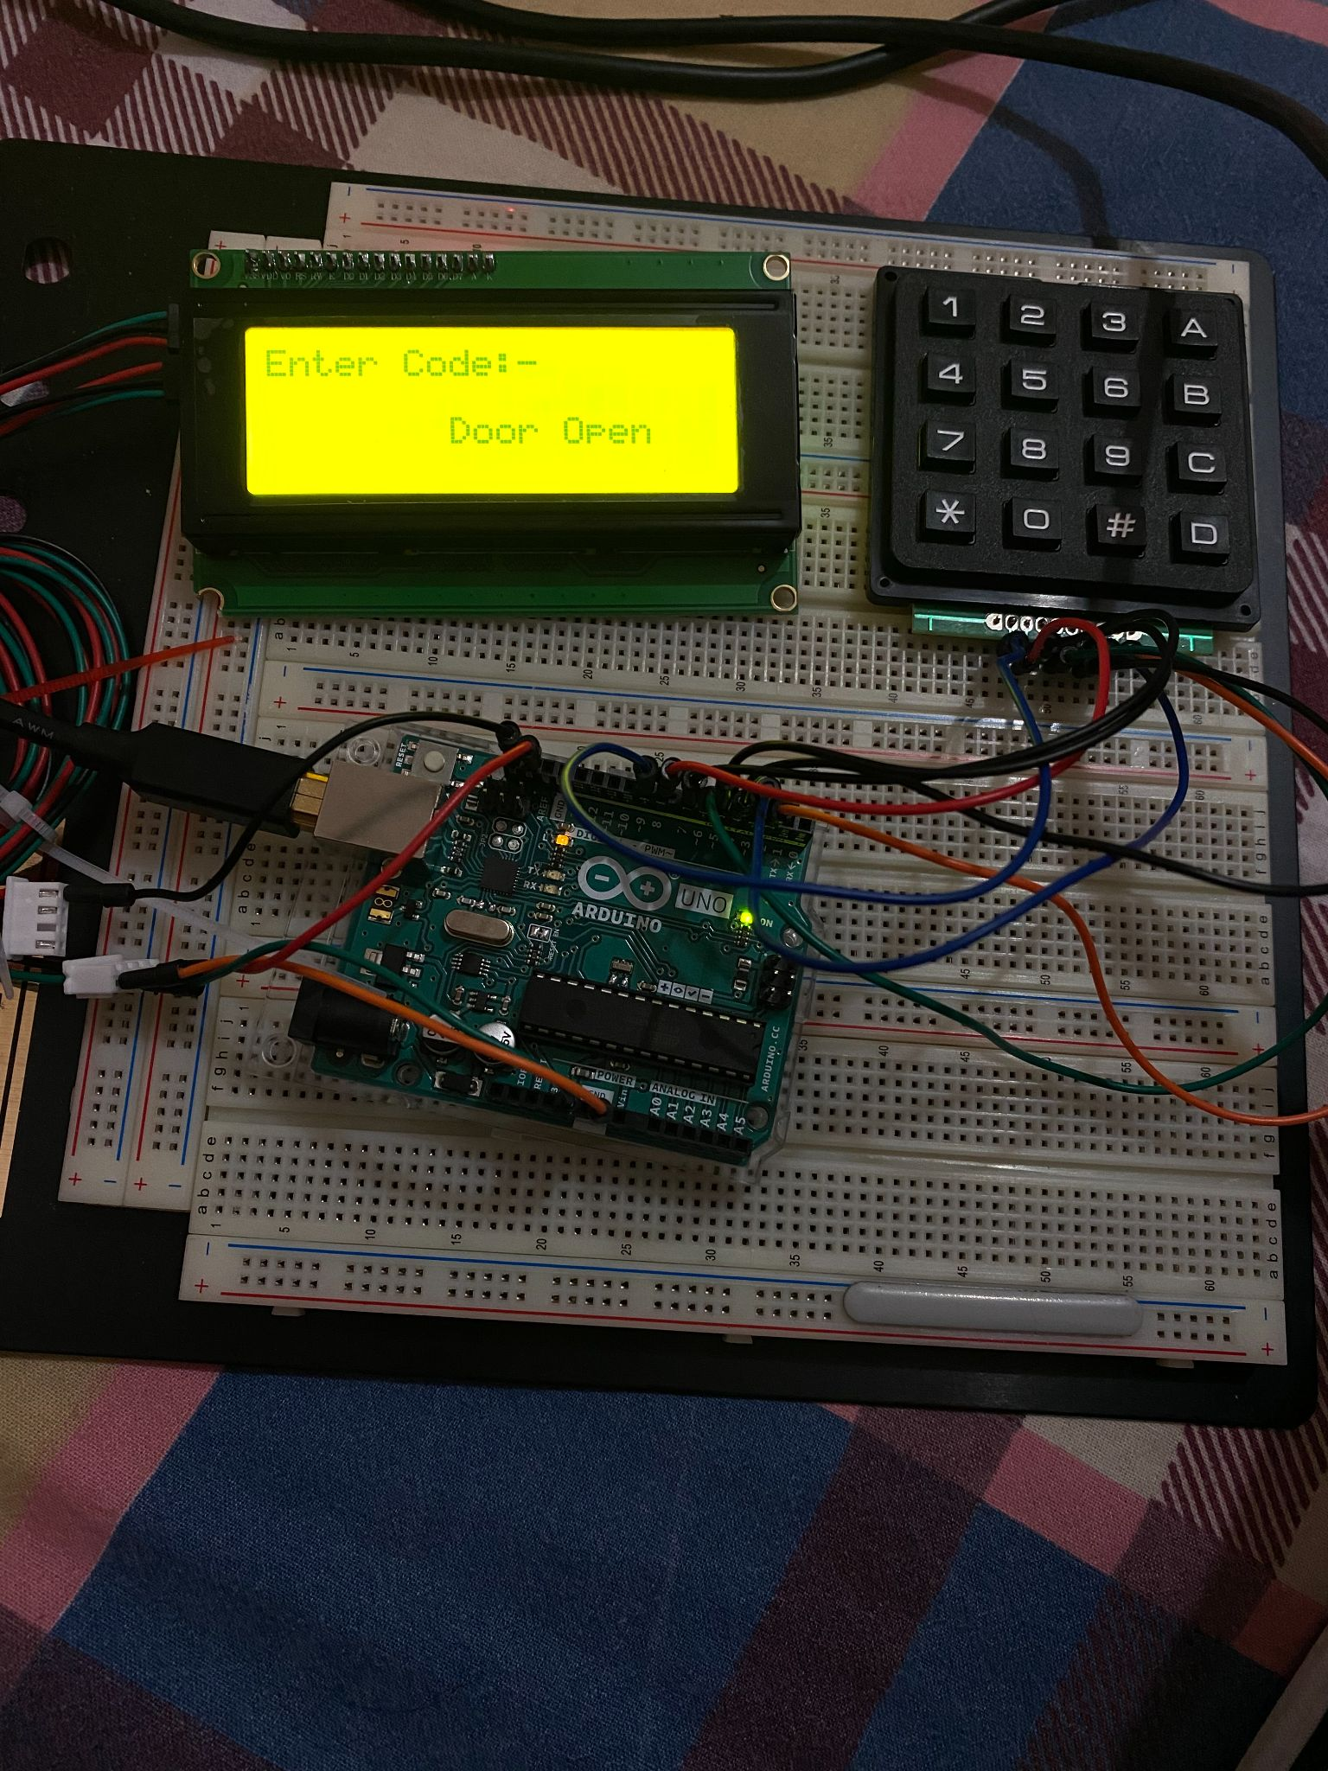
Hardware Connections

Slide 18
Code
#include "Wire.h" // For I2C communication
#include "LCD.h" // For LCD
#include "LiquidCrystal_I2C.h" // For I2C LCD display
#include "Adafruit_Keypad.h" // keypad library for arduino
#define KEYPAD_PID3844 // define the 4x4 matrix keypad

Slide 19
Code
#define R1 5 //connected pin 5 of arduino with pin 1 of ROW1
#define R2 4 //connected pin 4 of arduino with pin 2 of ROW2
#define R3 3 //connected pin 3 of arduino with pin 3 of ROW3
#define R4 2 //connected pin 2 of arduino with pin 4 of ROW4
#define C1 9 //connected pin 9 of arduino with pin 1 of COLUMN1
#define C2 8 //connected pin 8 of arduino with pin 2 of COLUMN2
#define C3 7 //connected pin 7 of arduino with pin 3 of COLUMN3
#define C4 6 //connected pin 6 of arduino with pin 4 of COLUMN4

Slide 20
Code
#include "keypad_config.h" // for keypad configuration
Adafruit_Keypad customKeypad = Adafruit_Keypad( makeKeymap(keys), rowPins, colPins, ROWS, COLS); //declaring keypad function
LiquidCrystal_I2C lcd(0x27, 2, 1, 0, 4, 5, 6, 7); // 0x27 is the default I2C bus address of the backpack (declaring LCD function)
int max_attempts =3; // define the no. of password attempts
int attempts =0; // initially 0
void setup() {
Serial.begin(9600); // serial baud rate
customKeypad.begin(); //keypad function call

Slide 21
Code
// Set off LCD module
lcd.begin (20, 4); // 20x4 LCD module
lcd.setBacklightPin(3, POSITIVE); // BL, BL_POL
lcd.setBacklight(HIGH); //to set the backlight
lcd.setCursor(0, 0); // setting the writing position
lcd.print(" Welcome to Garage"); // print on the LCD screen
lcd.setCursor(0, 1); // setting the writing position
lcd.print(" Monitoring System."); // print on the LCD
lcd.setCursor(0, 2); // setting the writing position
delay(5000); // delay operation

Slide 22
Code
lcd.clear(); // clear the screen
lcd.setCursor(0,0); // setting the writing position with row and column position
lcd.print("Enter Code:-"); // Enter the password
lcd.setCursor(0, 1); // to move the cursor
lcd.print(" "); // print on LCD
}
char GetKey; //declaration for characters
char KEY[4] = {'1', '2', '3', '4'}; // Array declaration for 4 digit password
char Check[4];
int c = 0; // set initial value 0

Slide 23
Code
void loop() // loop begins
if (c == 1) // if integer c is 1
{
lcd.setCursor(0, 1); // first row of lcd
lcd.print(GetKey); // print on the LCD
Check[0] = GetKey; //entered value assigns to the array address 0
}
else if (c == 2)
{
lcd.setCursor(1, 1); // second row of lcd
lcd.print(GetKey); // print on LCD
Check[1] = GetKey; // value assign to the array address 1
}

Slide 24
Code
else if (c == 3)
{
lcd.setCursor(2, 1); // third row of LCD
lcd.print(GetKey); // print on the LCD
Check[2] = GetKey; // value assign to the array address 2 }
else if (c == 4)
{
lcd.setCursor(3, 1); // fourth row of LCD
lcd.print(GetKey); // print on the LCD
Check[3] = GetKey; // value assign to the array address 3
c = 0;
if (Check[0] == KEY[0] && Check[1] == KEY[1] && Check[2] == KEY[2] && Check[3] == KEY[3]) // if entered values are same
{

Slide 25
Code
lcd.setCursor(0, 1);
lcd.print(" ");
lcd.setCursor(0, 2); // second row of LCD
lcd.print("Door Open"); // print Door Open on the LCD
lcd.setCursor(0, 1);
lcd.print(" ");
}
else { //if array element does not have same code then else statement runs
attempts=attempts+1; // if attempts exceeds more than 3
if (attempts >= max_attempts)
{
lcd.clear(); // clear the LCD
lcd.setCursor(0,2);

Slide 26
Code
lcd.print("Alert send"); // alert notification send
delay(5000); // delay operation
attempts=0; }
lcd.setCursor(0, 2);
lcd.print("Wrong Password"); // print wrong password
lcd.setCursor(0, 3);
lcd.print("Max 3 attempts"); //print maximum 3 attempts on LCD
delay(5000); // delay operation
lcd.clear();
lcd.setCursor(0,0);
lcd.print("Enter Code:-"); //again ask for password
lcd.setCursor(0, 1);
lcd.print(" ");
}
}

Slide 27
Code
customKeypad.tick(); //interrupt in if else loop
while (customKeypad.available()) // continuous loop begins
{
keypadEvent e = customKeypad.read(); //read the keypad entry
Serial.print((char)e.bit.KEY);
if (e.bit.EVENT == KEY_JUST_PRESSED) // if condition starts
{
Serial.println(" pressed"); // shows pressed status
GetKey = (char)e.bit.KEY; // character key
if (GetKey == 'D') // if key is D (alpha numeric key)
{
lcd.setCursor(0, 3);
lcd.print(" ");
lcd.setCursor(0, 3);
lcd.print("DOOR CLOSING"); // print Door closing on the LCD

Slide 28
Code
delay(2000); //delay operation
lcd.setCursor(0, 3);
lcd.print(" ");
}
else c++;
}
else if (e.bit.EVENT == KEY_JUST_RELEASED) Serial.println(" released"); // key released
}
}

Slide 29
Code: keypad_config.h
#ifndef __KEYPAD_CONFIG_H__
#define __KEYPAD_CONFIG_H__
#if defined(KEYPAD_PID3844)
const byte ROWS = 4; // four rows
const byte COLS = 4; // four columns
// define the symbols on the buttons of the keypads
char keys[ROWS][COLS] = {{'1', '2', '3', 'A'},
{'4', '5', '6', 'B'},
{'7', '8', '9', 'C'},
{'*', '0', '#', 'D'}};
byte rowPins[ROWS] = {R1, R2, R3,
R4}; // connect to the row pinouts of the keypad
byte colPins[COLS] = {C1, C2, C3,
C4}; // connect to the column pinouts of the keypad
#endif

Slide 30
Code
#if defined(KEYPAD_PID1824) || defined(KEYPAD_PID3845) || defined(KEYPAD_PID419)
const byte ROWS = 4; // rows
const byte COLS = 3; // columns
// define the symbols on the buttons of the keypads
char keys[ROWS][COLS] = {
{'1', '2', '3'}, {'4', '5', '6'}, {'7', '8', '9'}, {'*', '0', '#'}};
byte rowPins[ROWS] = {R1, R2, R3,
R4}; // connect to the row pinouts of the keypad
byte colPins[COLS] = {C1, C2, C3}; // connect to the column pinouts of the
// keypad
#endif

Slide 31
Code
#if defined(KEYPAD_PID1332)
const byte ROWS = 1; // rows
const byte COLS = 4; // columns
// define the symbols on the buttons of the keypads
char keys[ROWS][COLS] = {
{'1', '2', '3', '4'},
};
byte rowPins[ROWS] = {R1}; // connect to the row pinouts of the keypad
byte colPins[COLS] = {C1, C2, C3,
C4}; // connect to the column pinouts of the keypad
#endif
#endif

Slide 32
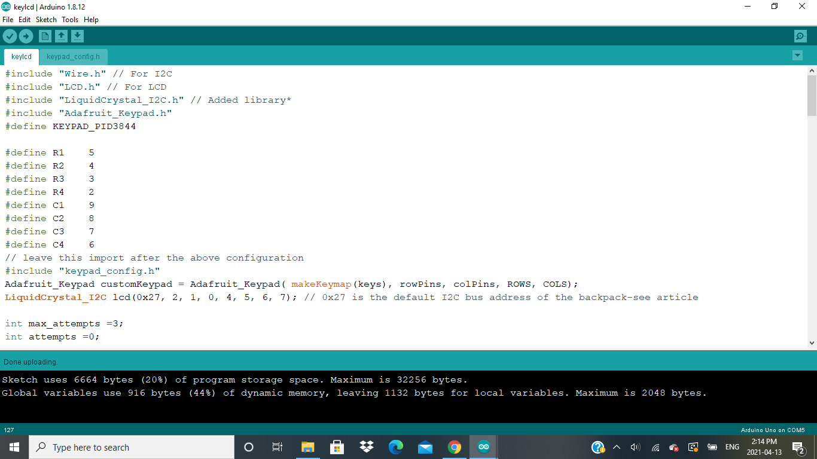
Code Explanation: Screen shots

Slide 33
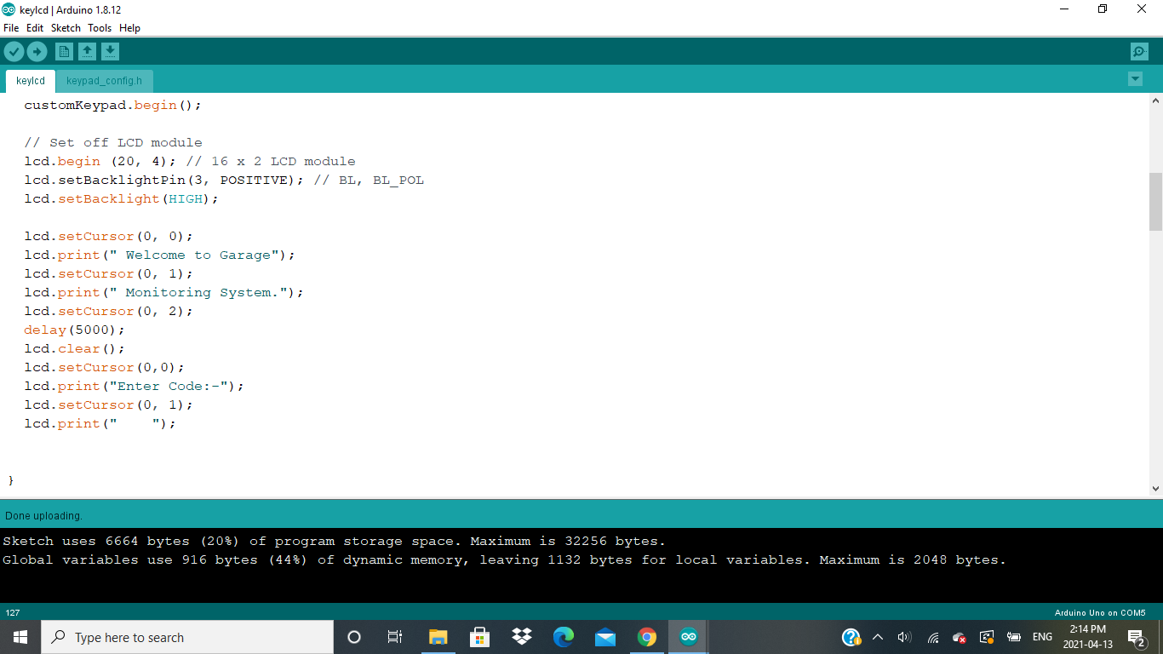

Slide 34
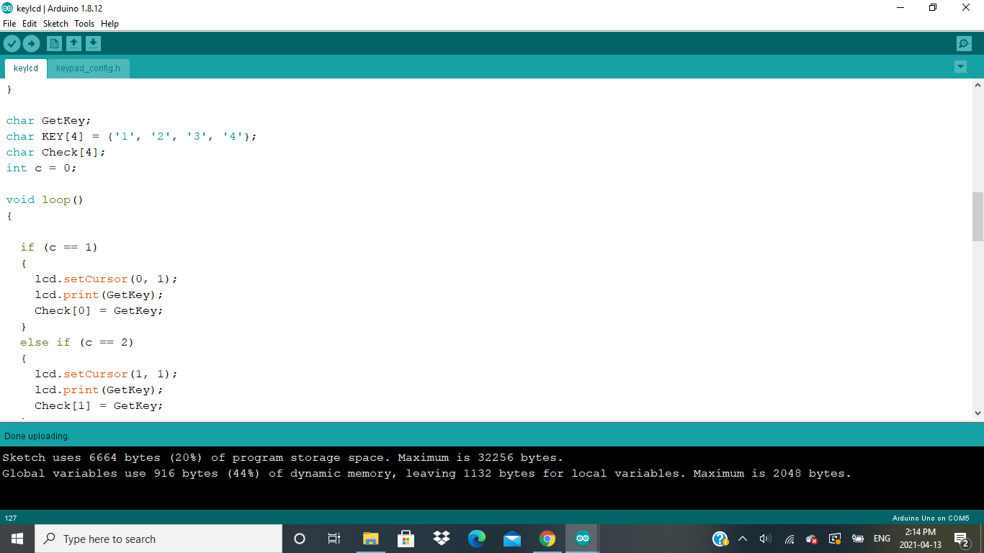

Slide 35


Slide 36
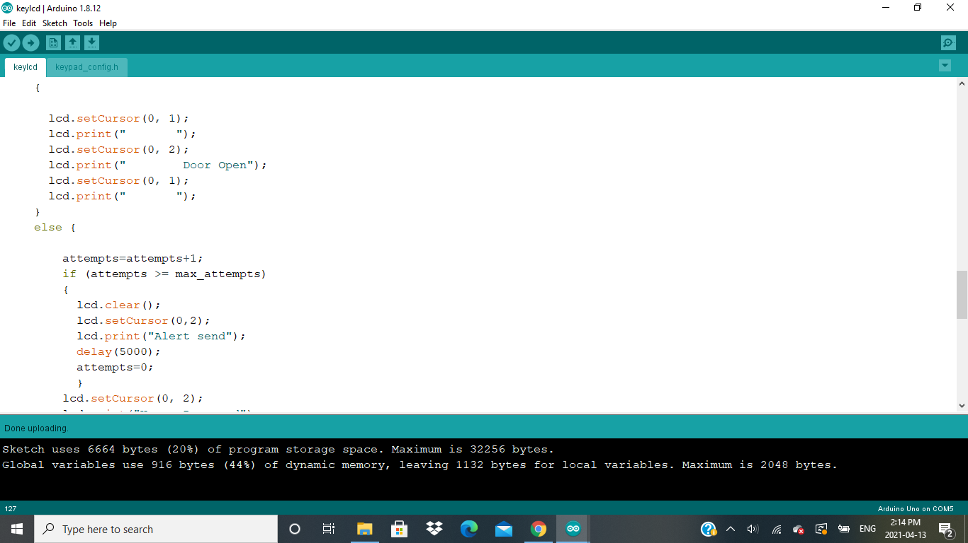

Slide 37
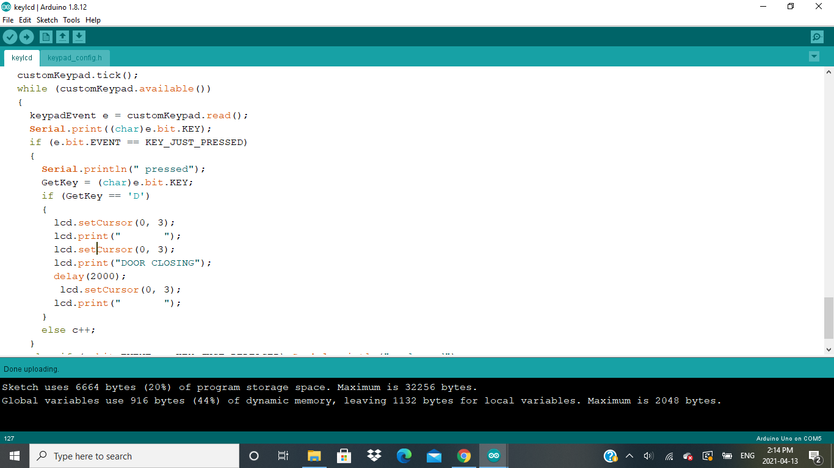

Slide 38
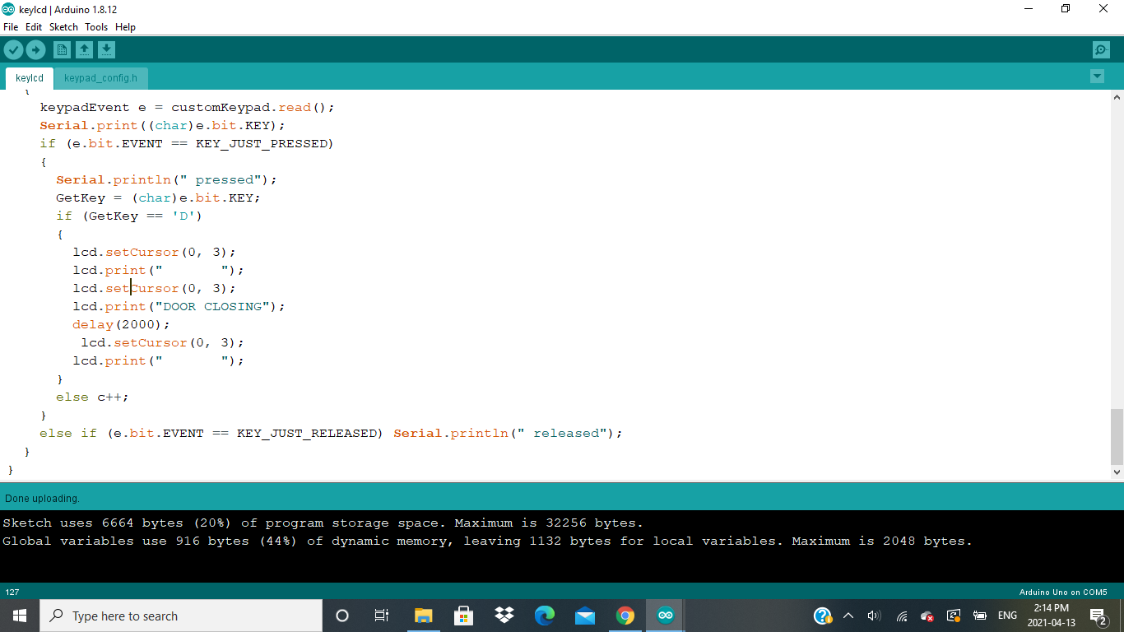

Slide 39
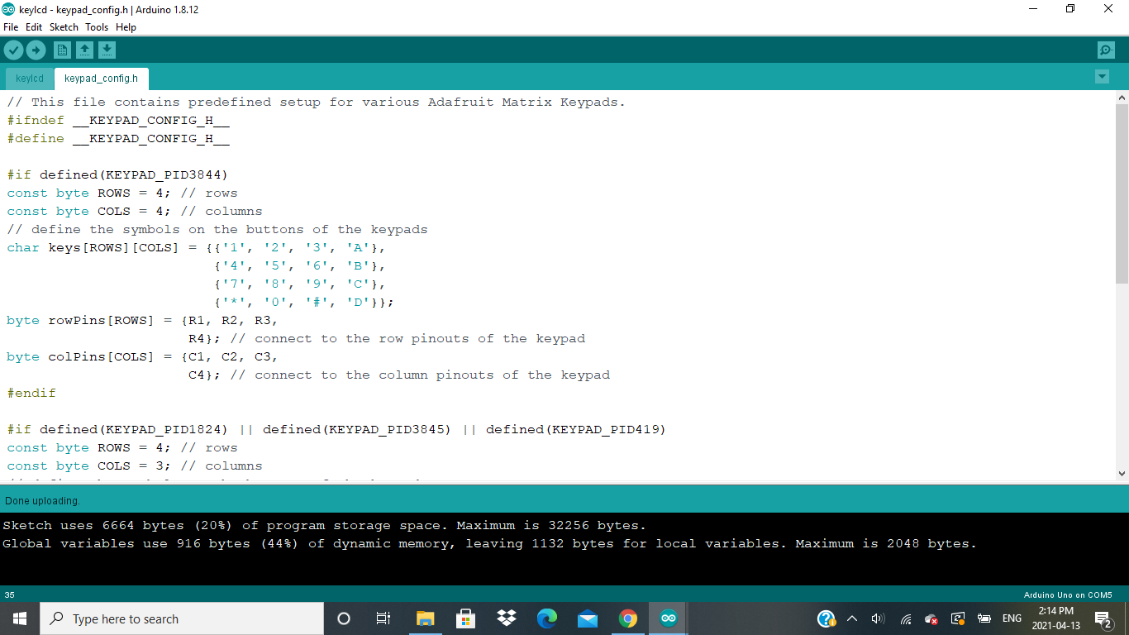

Slide 40
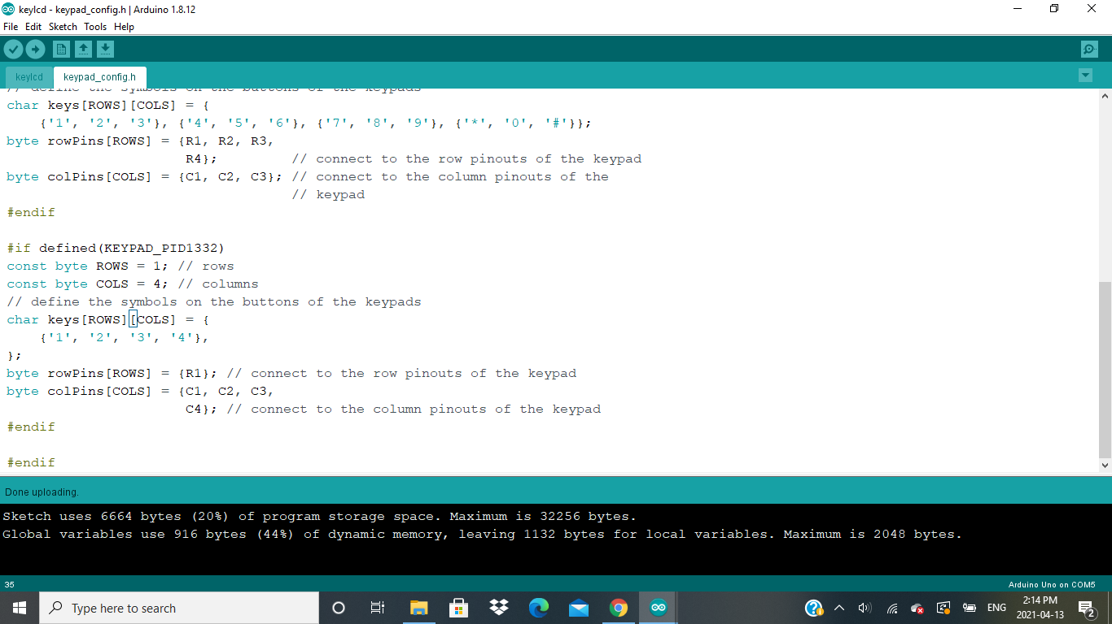

Slide 41
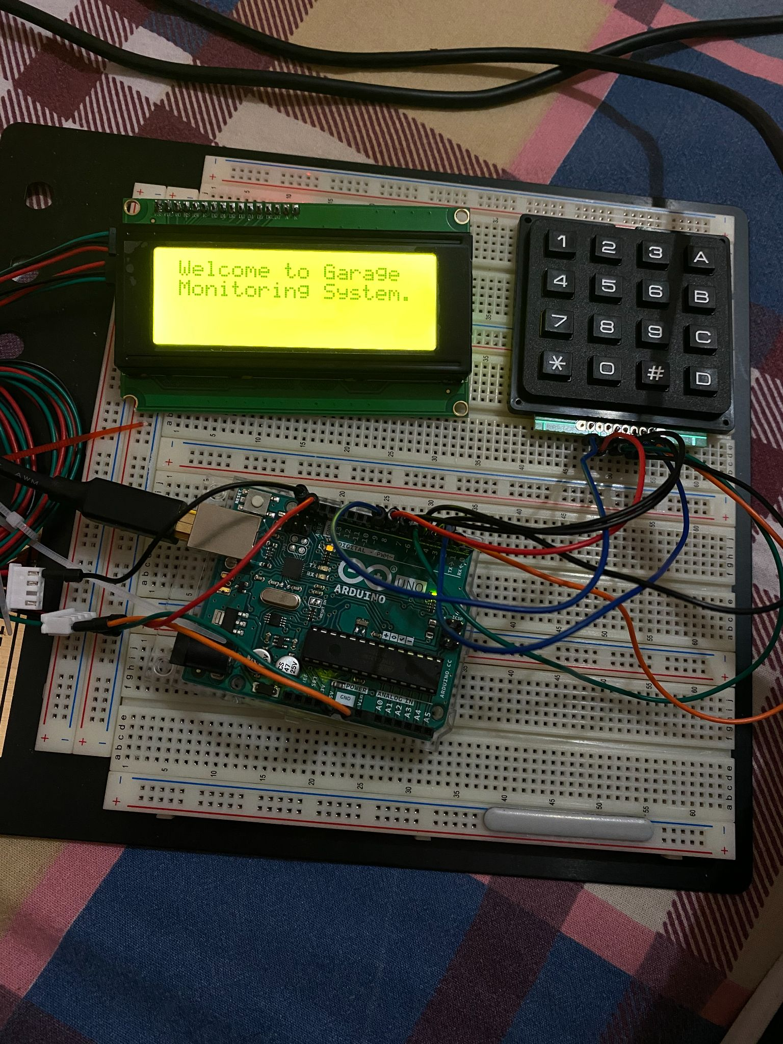
OUTPUT:

Slide 43
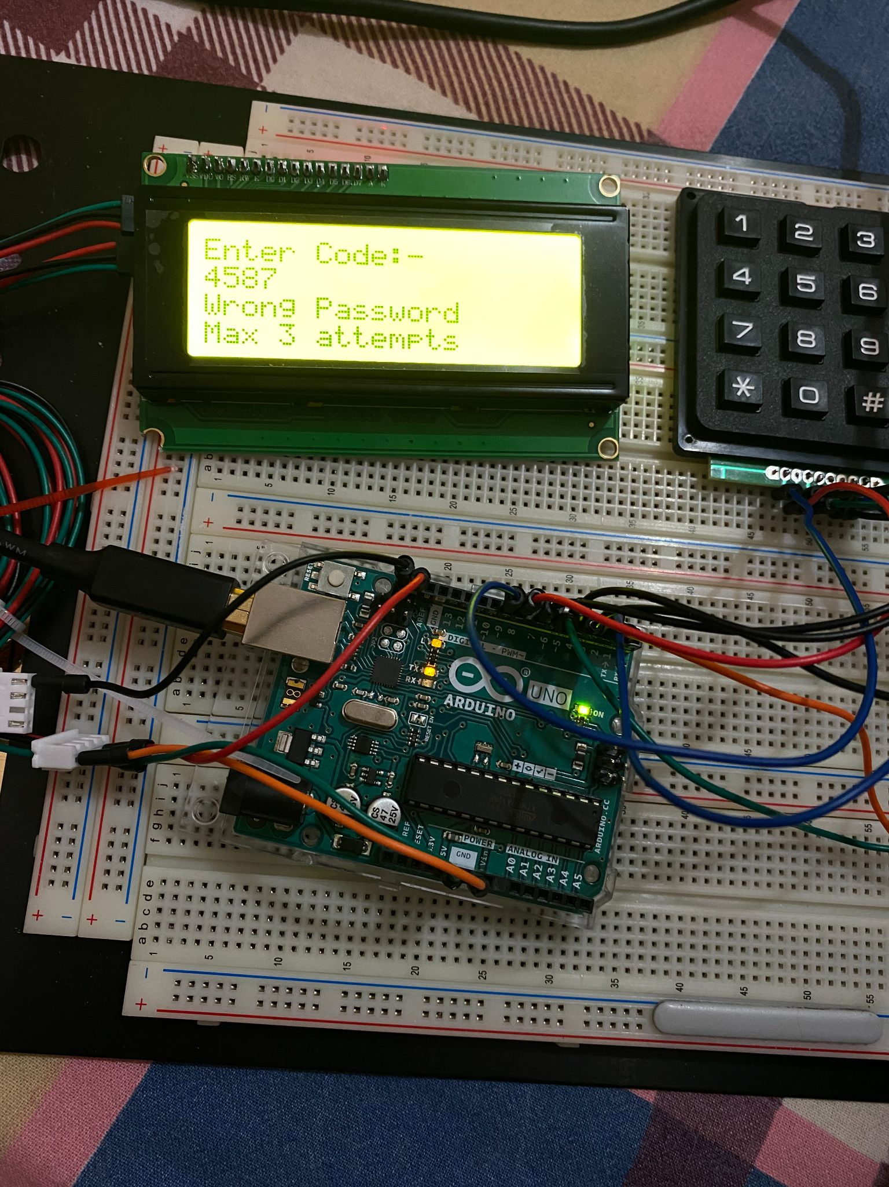

Slide 44
References
Retrieved from eTechnophiles.com, URL:
https://www.etechnophiles.com/arduino-uno-pinout-pin-diagram-specifications
Retrieved from components101.com, URL:
https://components101.com/misc/4x4-keypad-module-pinout-configuration-features-datasheet

Slide 45
References
Retrieved from electroniclinic.com, URL:
https://www.electroniclinic.com/password-door-lock-security-system-using-arduino-and-keypad/
Retrieved from surtrtech.com, URL:
https://surtrtech.com/2018/01/27/arduino-lcd-i2c-simple-use-and-direct-write-from-serial-monitor/
Retrieved from Youtube.com, URL:
https://www.youtube.com/watch?v=wfdcJASjqB0

